Slide 1
Cassandra Query Language
Users can access Cassandra through its nodes using Cassandra Query Language (CQL).
CQL treats the database (Keyspace) as a container of tables. Programmers use cqlsh: a prompt to work with CQL or separate application language drivers.
Clients approach any of the nodes for their read-write operations. That node (coordinator) plays a proxy between the client and the nodes holding the data.

Slide 2
Cassandra - Data Model
Cluster
Cassandra database is distributed over several machines that operate together. The outermost container is known as the Cluster.
Keyspace
Keyspace is the outermost container for data in Cassandra. The basic attributes of a Keyspace in Cassandra are −
Replication factor
Replica placement strategy
Column families
Notes:
Cassandra database is distributed over several machines that operate together. The outermost container is known as the Cluster. For failure handling, every node contains a replica, and in case of a failure, the replica takes charge. Cassandra arranges the nodes in a cluster, in a ring format, and assigns data to them.

Slide 3
The syntax of creating a Keyspace is as follows −
CREATE KEYSPACE Keyspace name
WITH replication = {'class': 'SimpleStrategy', 'replication_factor' : 3};

Slide 4
Data Models of Cassandra and RDBMS
RDBMS | Cassandra
RDBMS deals with structured data. | Cassandra deals with unstructured data.
It has a fixed schema. | Cassandra has a flexible schema.
In RDBMS, a table is an array of arrays. (ROW x COLUMN) | In Cassandra, a table is a list of “nested key-value pairs”. (ROW x COLUMN key x COLUMN value)
Database is the outermost container that contains data corresponding to an application. | Keyspace is the outermost container that contains data corresponding to an application.
Tables are the entities of a database. | Tables or column families are the entity of a keyspace.
Row is an individual record in RDBMS. | Row is a unit of replication in Cassandra.
Column represents the attributes of a relation. | Column is a unit of storage in Cassandra.
RDBMS supports the concepts of foreign keys, joins. | Relationships are represented using collections.

Slide 5
References
https://www.tutorialspoint.com/cassandra
https://cassandra.apache.org/
https://www.datastax.com/products/apache-cassandra
https://www.guru99.com/cassandra-tutorial.html

Slide 6
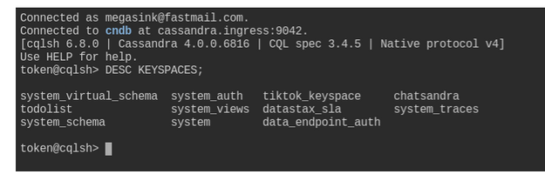
CASSANDRA-CRUD
Step 1. Navigate to the CQL Console and login to the database
Step 2. Describe keyspaces and USE one of them
DESC KEYSPACES;
"desc" is short for "describe", either is valid.
CQL commands usually end with a semicolon ;. If you hit Enter, nothing happens and you don't even get your prompt back, most likely it's because you have not closed the command with ;. If in trouble, you can always get back to the prompt with Ctrl-C and start typing the command anew.

Slide 7
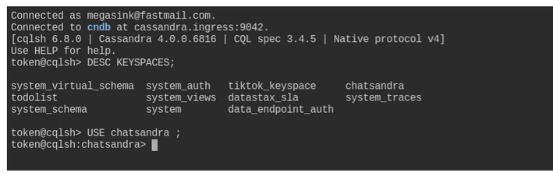
Depending on your setup you might see a different set of keyspaces than in the image. The one we care about for now is chatsandra. From here, execute the USE command with the chatsandra keyspace to tell the database our context is within chatsandra.
USE chatsandra;
Step 3. Create the users table
At this point we can execute a command to create the users table.

Slide 8
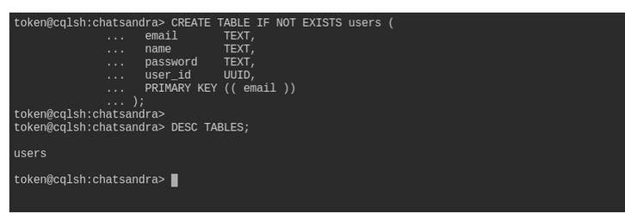
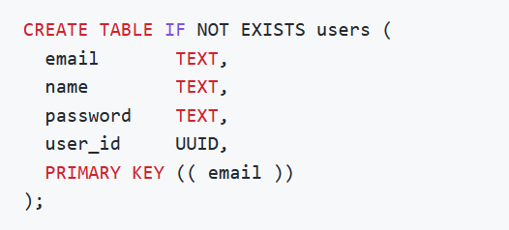
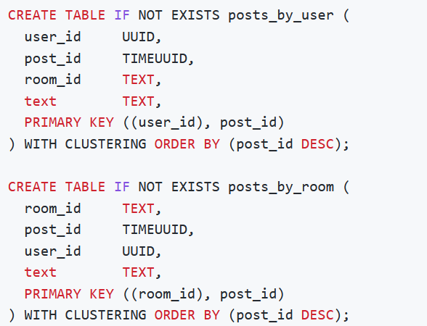
DESC TABLES;
Step 4: Create the tables for posts
Let us create two more tables, which will contain the posts. As remarked earlier, we will store the posts in two tables which differ in how they are partitioned: look at the commands below, the differences mostly lie in the PRIMARY KEY specification:
first look at the application's needs, determine the required workflows, then map them to a number of queries, finally design a table around each query.
We create table posts_by_user to support a query such as "get all posts by a user X"; then we also need table posts_by_room for a query of type "get all posts in room Y".
The two tables have the same columns, but the different choice of partition key is what will make the two queries possible on the respective tables.

Slide 9
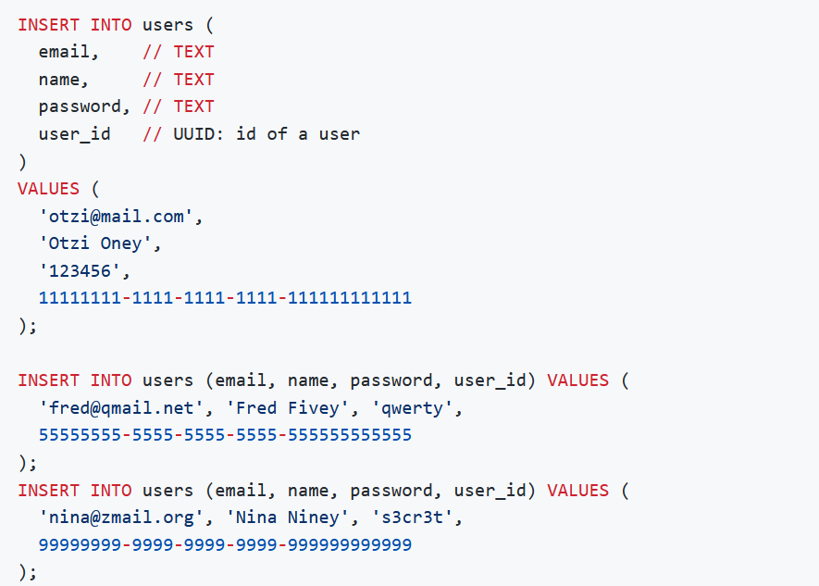
Execute CRUD operations
(C)RUD :
Our tables are in place so let's put some data in them. This is done with the INSERT statement. We'll start by inserting three rows into the users table.

Slide 10
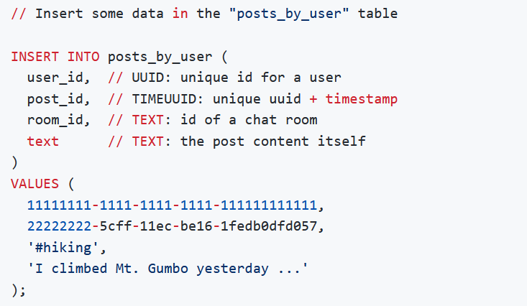
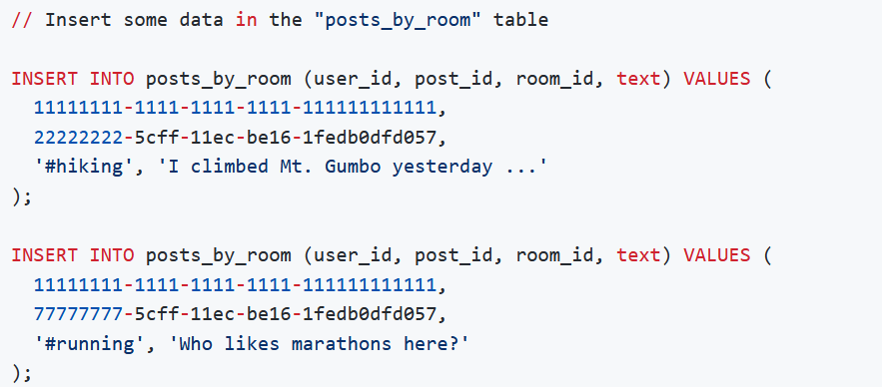

Slide 11
C(R)UD

Slide 12
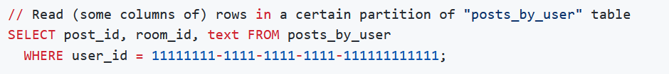
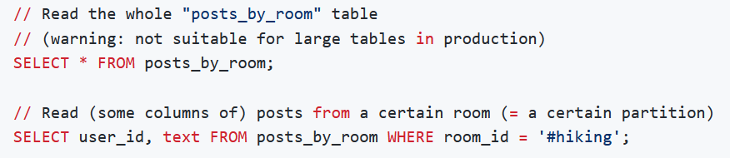
The key is to ensure we are always selecting by some partition key at a minimum, so to avoid the dreaded full-cluster scans which yield performances that are generally unacceptable in production.

Slide 13
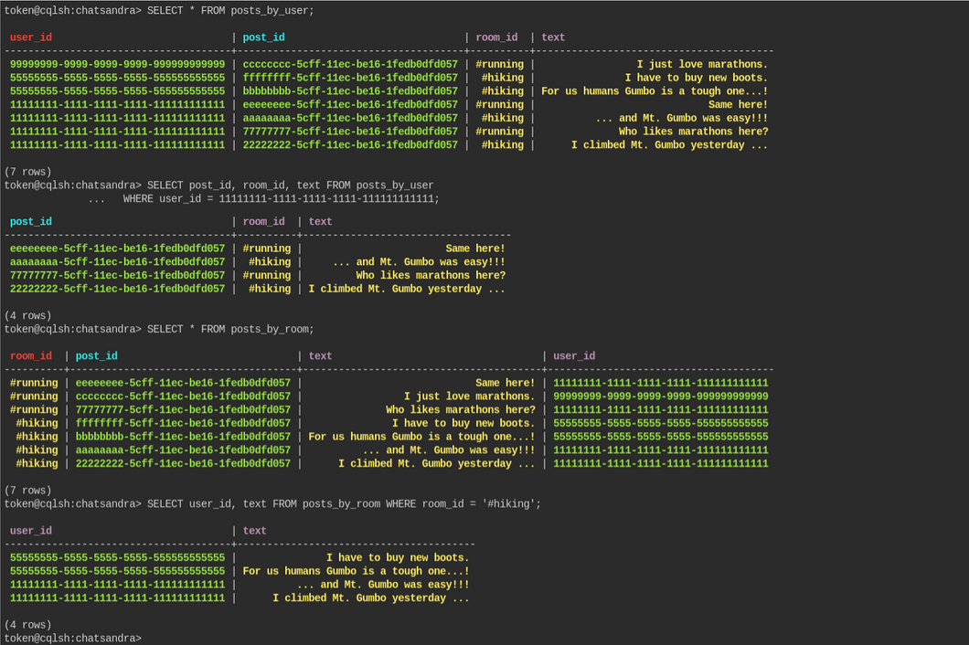

Slide 14
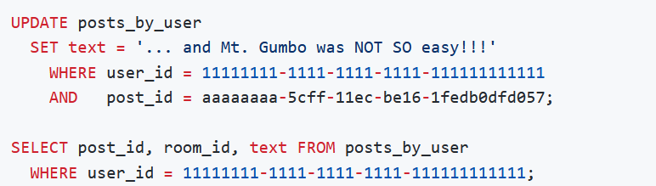
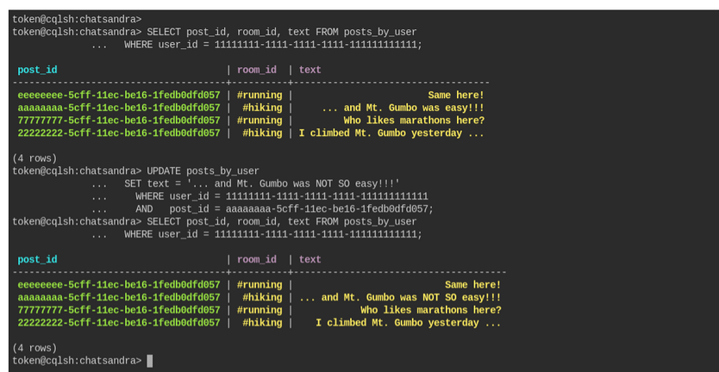
CR(U)D

Slide 15
CRU(D)
The final operation from our CRUD acronym is DELETE. This is the operation we use when we want to remove data from the database.
In Apache Cassandra you can DELETE from the cell level all the way up to the partition (meaning I could remove a single column in a single row or I could remove a whole partition) using the same DELETE command.
It's best to perform as few delete operations as possible on the largest amount of data. Think of it this way, if you want to delete ALL data in a table, don't delete each individual cell, just TRUNCATE the table. I
f you need to delete all the rows in a partition, don't delete each row, DELETE the partition, and so on.

Slide 16
